Slide 1

Extensible and Reusable Controls
XControls and Object-Oriented Controls
Quentin “Q” Alldredge
Q Software Innovations, LLC
q@qsoftwareinnovations.com

Slide 2
Overview
Definitions
Goal
Basic Controls
XControls
Control Classes

Slide 3
Definitions
Skin
Appearance of the User Interface (i.e. use of Modern, System, or Silver Controls or creation of custom skinned controls)
UI Logic
Code that controls elements of the User Interface (i.e. checkboxes, color changes, enable/disable, etc.)
Business Logic
Code that controls other aspects of the program (i.e. data acquisition, data analysis, file system, etc.)

Slide 4
Goal
Create UI Elements that are extensible and reusable by:
Separating UI Logic from Business Logic
Separating Skin from UI Logic
Encapsulating UI Logic
Encapsulating Skin

Slide 5
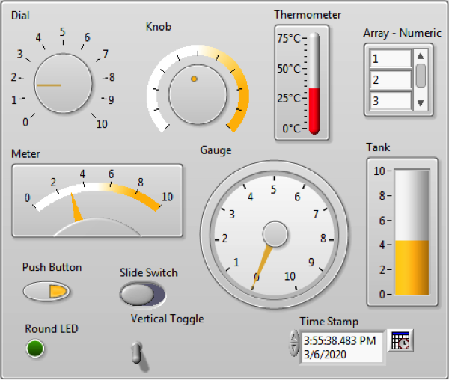
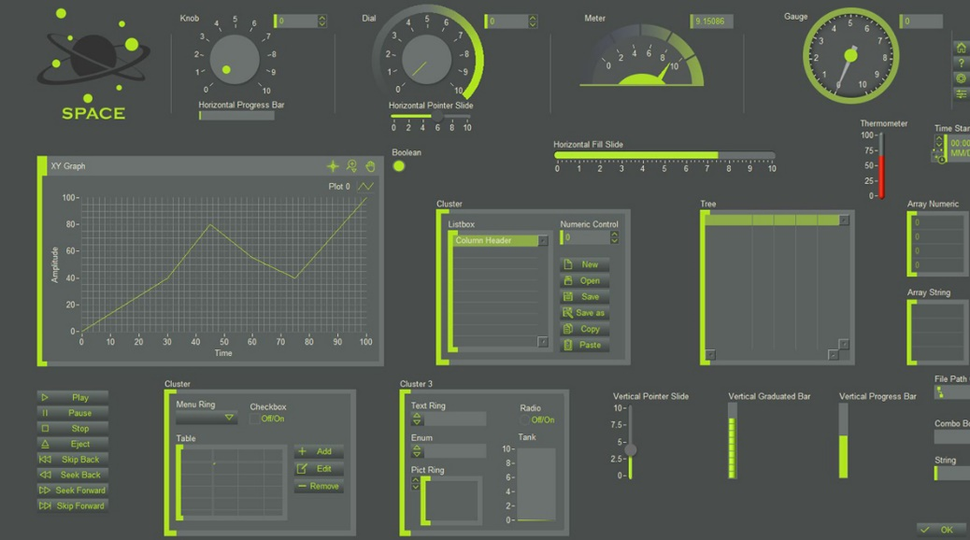
Basic Controls
Pros
Simple
Basic Functionality
Skinnable
Cons
UI Code Mixed with Business Logic
Not easily Reusable
Skinining is difficult must be done in Control or Strict-Type Control
Some Properties not available on Strict-Type Controls

Slide 6
Basic Controls
Demo

Slide 7
XControls
What is an XControl?
An XControl is a specialized library where you combine built-in LabVIEW controls and indicators to take advantage of the combined functionality of the built-in LabVIEW controls and indicators.
A typical XControl library will contain Abilities, Properties, and Methods.
Abilities define the appearance, data type, display state, and initialization of the XControl

Slide 8
XControls - Parts
Contains Main Parts called “Abilities”
Init.vi
State.ctl
Data.ctl
Façade.vi
Required
Uninit.vi
Convert State for Save.vi
Optional
Interface
Properties
Methods

Slide 9
XControls - Parts
Contains Main Parts called “Abilities”
Init.vi
The Init.vi function runs when the XControl gets loaded into memory (VI load or Library/Class load).
Convert various revisions of the saved State.
Init.vi
State.ctl
Data.ctl
Façade.vi
Required
Uninit.vi
Convert State for Save.vi
Optional
Interface
Properties
Methods

Slide 10
XControls - Parts
Contains Main Parts called “Abilities”
Init.vi
State.ctl
Data.ctl
Façade.vi
Required
State.ctl
The State Control is the data space/container for the XControl from one execution to the next and is saved with the VI the XControl is used in.
Uninit.vi
Convert State for Save.vi
Optional
Interface
Properties
Methods

Slide 11
XControls - Parts
Contains Main Parts called “Abilities”
Init.vi
State.ctl
Data.ctl
Façade.vi
Data.ctl
The Data Control is the definition of the data type for the XControl.
It can be any control type but be careful when making the type a class.
Required
Uninit.vi
Convert State for Save.vi
Optional
Interface
Properties
Methods

Slide 12
XControls - Parts
Contains Main Parts called “Abilities”
Façade.vi
The Façade.vi is the skin and the UI logic. Always running in the background to respond to events.
Has Built-in Events for:
Data Change – A value was written to the XControl's terminal, local or value property.
Display State Change – Display State changed as a result of dropping a new instance of this XControl, copying, undoing an operation or executing a custom property or method on this XControl.
Direction Change – The XControl changed from a control to an indicator or vice versa.
Exec State Change – The VI owning the XControl changed from Edit Mode to Run Mode or vice versa.
Init.vi
State.ctl
Data.ctl
Façade.vi
Required
Uninit.vi
Convert State for Save.vi
Optional
Interface
Properties
Methods

Slide 13
XControls - Parts
Contains Main Parts called “Abilities”
Init.vi
State.ctl
Data.ctl
Façade.vi
Required
Uninit.vi
The Uninit.vi is optional.
Runs when the XControl is leaving memory. This occurs when the owning VI is leaving memory unless the owning VI is a VI in a Class or Library. If so, then it is when the Class or Library leaves memory.
Uninit.vi
Convert State for Save.vi
Optional
Interface
Properties
Methods

Slide 14
XControls - Parts
Contains Main Parts called “Abilities”
Init.vi
State.ctl
Data.ctl
Façade.vi
Required
Convert State for Save.vi
The Convert State for Save.vi is optional.
Runs when the XControl is leaving memory just like the Uninit.vi. Use this to reduce what is in the State.ctl to that which you want saved.
If using this the Init.vi must be modified to handle reading the saved state and converting it back to the full state cluster.
Uninit.vi
Convert State for Save.vi
Optional
Interface
Properties
Methods

Slide 15
XControls - Parts
Contains Main Parts called “Abilities”
Init.vi
State.ctl
Data.ctl
Façade.vi
Required
Properties
Group of VIs that can have one input (Write) or one output (Read). These are accessed through property nodes in the owning VI when the XControls reference is wired into the node.
When any are executed the Display State Change Event will fire.
Uninit.vi
Convert State for Save.vi
Optional
Interface
Properties
Methods

Slide 16
XControls - Parts
Contains Main Parts called “Abilities”
Methods
Group of VIs that can have multiple inputs and/or outputs. These are accessed through invoke nodes in the owning VI when the XControls reference is wired into the node.
Inputs and Outputs must be configured in the method setup dialog and identified as required or optional.
When any are executed the Display State Change Event will fire.
Init.vi
State.ctl
Data.ctl
Façade.vi
Required
Uninit.vi
Convert State for Save.vi
Optional
Interface
Properties
Methods

Slide 17
XControls
Demo

Slide 18
XControls
Pros
Cons
Encapsulates Skin and UI Logic
Date Type is settable and terminals become the data type
Acts just like a regular control in the owning VI
Can program custom edit time behavior as well as run time behavior
Can have more than one control in the Façade for more complex UIs
Skin and UI Logic are coupled
Harder to work with in edit time unless a lot of work is put into it
Not recommended for use in classes or libraries due to loading issues (be careful of circular dependency)
Do not use Actor Framework in XControl if using XControl in an Actor Core (Circular Dependency)
Slightly crashy

Slide 19
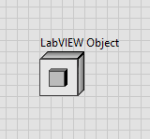
Control Classes
What is a Control Class?
Class with a Control Reference as part of its Private Data
All manipulation of the Control should be done through Properties and Methods of its Class
Not to be confused with Class Controls
Control Class can be reused to recreate the UI Logic wherever required
Asynchronously called Event Hander handles UI Logic
Using the Control Class Hierarchy Toolkit mimics the VI Server Class Hierarchy

Slide 20
Object-Oriented LabVIEW

Slide 21
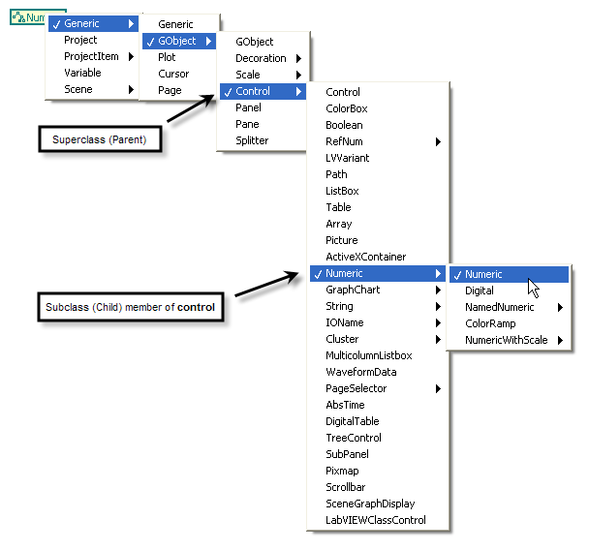
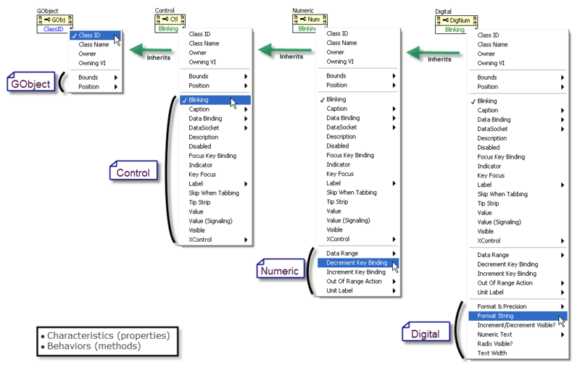
VI Server Class Hierarchy

Slide 22
VI Server Class Hierarchy
Classes

Slide 23
VI Server Class Hierarchy
Classes
Properties

Slide 24
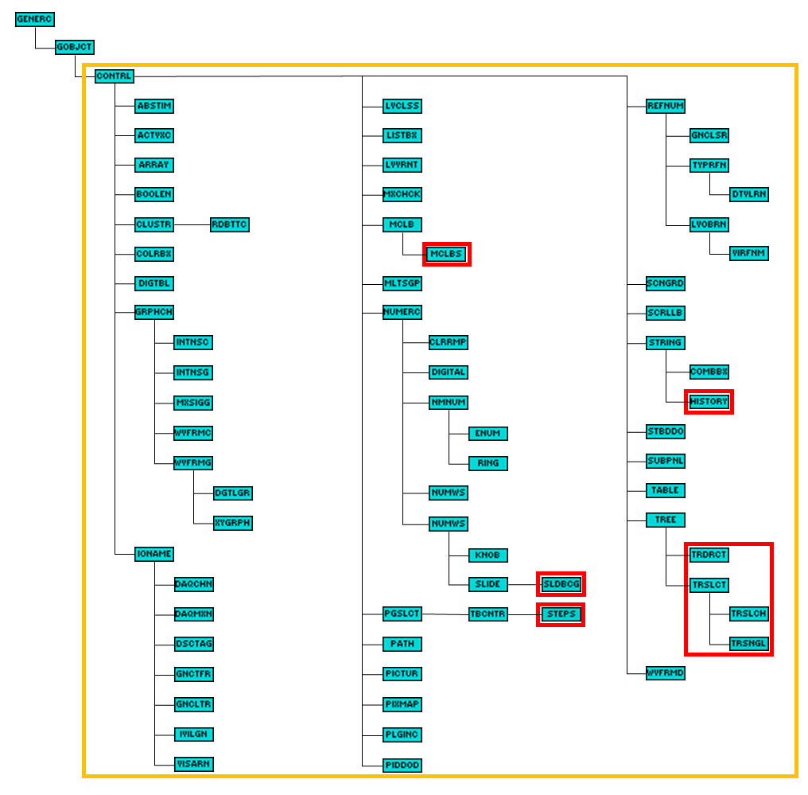
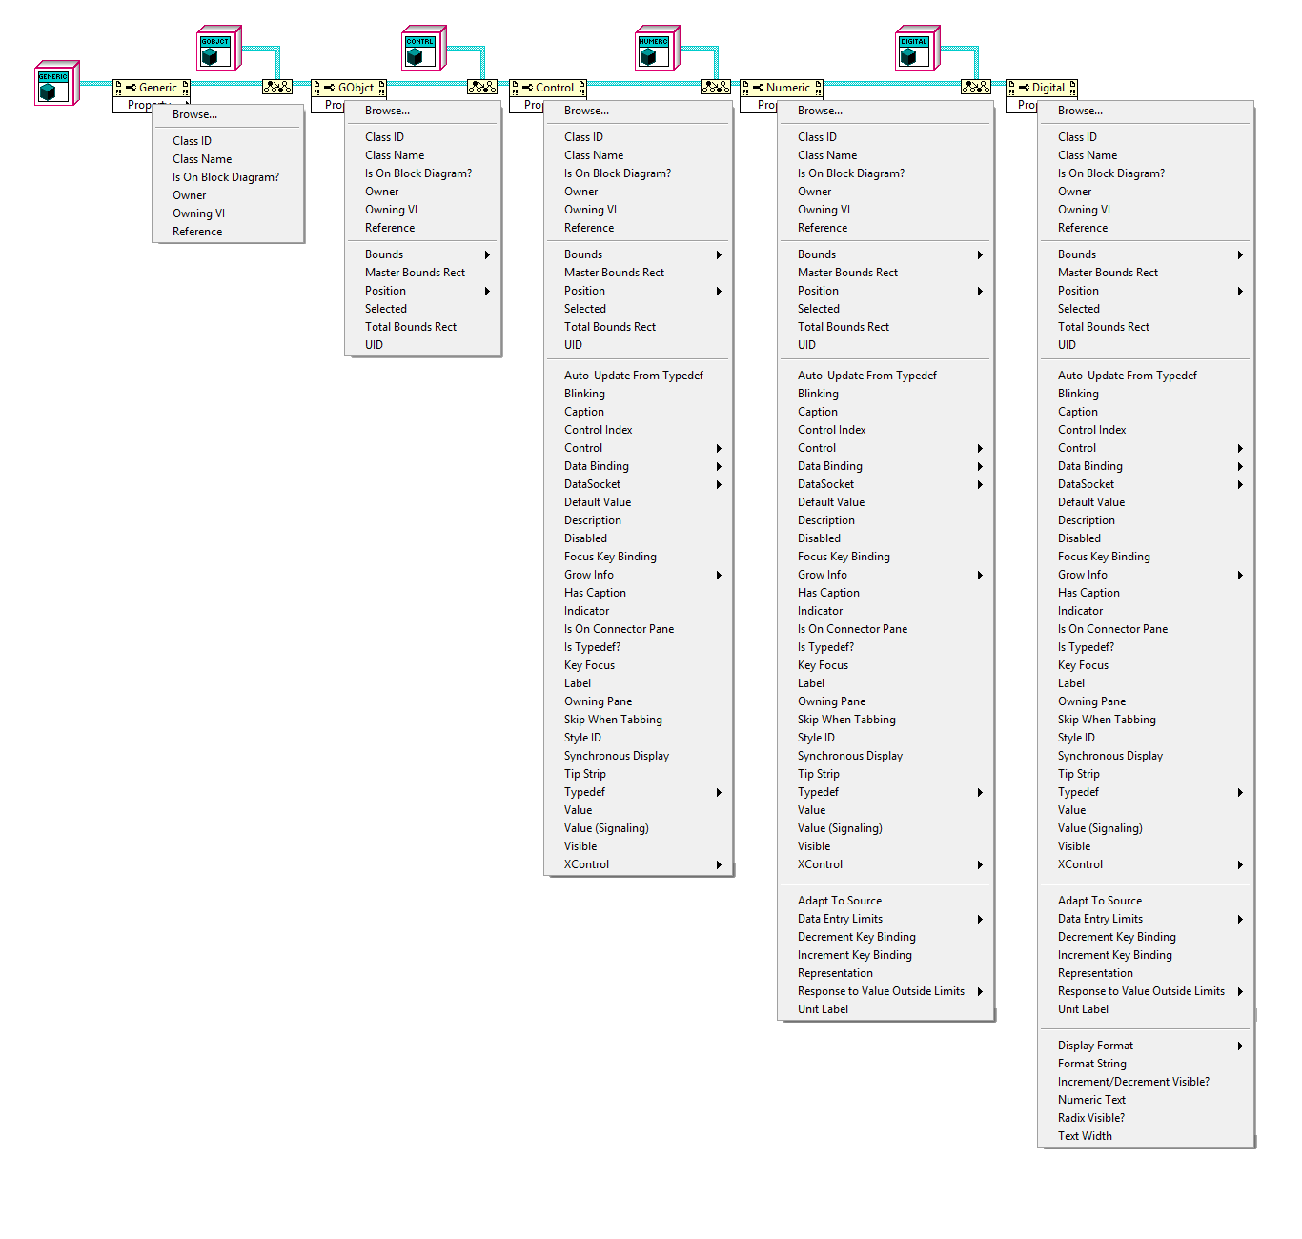
Control Classes Hierarchy Toolkit

Slide 25
Control Classes Hierarchy Toolkit
Classes

Slide 26
Control Classes Hierarchy Toolkit
Classes
Properties

Slide 27
Control Classes - Parts
Class Definition
Class Private Data
LVClass
Initialize
Event Handler
Close
Dynamic
Overrides
Properties
Methods
Interface

Slide 28
Control Classes - Parts
Class Definition
The control is first defined as a class that inherits from the Control Class.
By inheriting new Class inherits:
Properties of Classes in Inheritance Hierarchy
Automatic Handling of References
Automatic Launching of Event Handler, if Event Handler is overridden.
Class Definition
Class Private Data
LVClass
Initialize
Event Handler
Close
Dynamic
Overrides
Properties
Methods
Interface

Slide 29
Control Classes - Parts
Class Definition
Class Private Data
Class Private Data
Include any data that is necessary for the class.
Properties
Colors
Fonts
Flags
State Data
Flags
References
Selections
LVClass
Initialize
Event Handler
Close
Dynamic
Overrides
Properties
Methods
Interface

Slide 30
Control Classes - Parts
Class Definition
Class Private Data
LVClass
Initialize.vi
Optional unless overriding the Event Handler.
Use in code after reference is loaded into control.
Initialize must call parent method.
Include any initialization code needed for the control
Recommended to use the Initialize.vi in the initialization step of the code it is used in.
Initialize
Event Handler
Close
Dynamic
Overrides
Properties
Methods
Interface

Slide 31
Control Classes - Parts
Class Definition
Class Private Data
LVClass
Event Handler.vi
Optional Override.
Launched Asynchronously in Initialize.vi
Use to handle all UI Logic.
If used Initialize.vi and Close.vi must be used.
Initialize
Event Handler
Close
Dynamic
Overrides
Properties
Methods
Interface

Slide 32
Control Classes - Parts
Class Definition
Class Private Data
LVClass
Close.vi
Optional override.
Must call parent method.
Include any cleanup code needed for the control
Must be used in the cleanup step of the code it is used in.
The method or the parent method must be used to close Event Handler.vi and close control reference.
Initialize
Event Handler
Close
Dynamic
Overrides
Properties
Methods
Interface

Slide 33
Control Classes - Parts
Class Definition
Class Private Data
LVClass
Properties
Group of VIs that can have one input (Write) or one output (Read). These are accessed through property nodes in the owning VI when the class wire is wired into the node.
Property Vis are defined by the Property Definition Folder in a Class.
Initialize
Event Handler
Close
Dynamic
Overrides
Properties
Methods
Interface

Slide 34
Control Classes - Parts
Class Definition
Class Private Data
LVClass
Methods
Group of VIs that can have multiple inputs and/or outputs. Only accessable by using the VI itself on the block diagram of the control’s owning VI.
Initialize
Event Handler
Close
Dynamic
Overrides
Properties
Methods
Interface

Slide 35
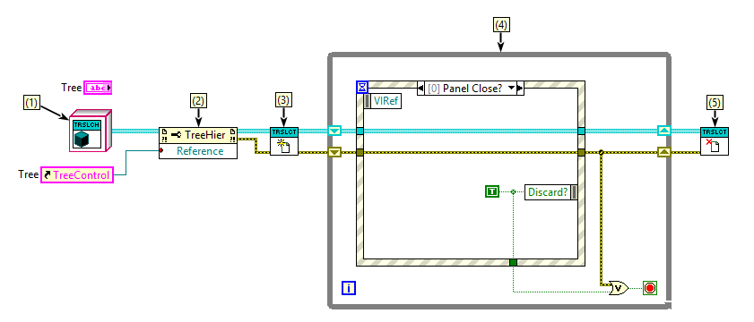
Control Classes - Usage

Slide 36
Control Classes - Usage
(1) Class Definition

Slide 37
Control Classes - Usage
(1) Class Definition
(2) Load Reference

Slide 38
Control Classes - Usage
(1) Class Definition
(3) Initialize
(2) Load Reference

Slide 39
Control Classes - Usage
(1) Class Definition
(3) Initialize
(4) Application Business Logic
(2) Load Reference

Slide 40
Control Classes - Usage
(1) Class Definition
(3) Initialize
(5) Close
(4) Application Business Logic
(2) Load Reference

Slide 41
Control Classes
Demo

Slide 42
Control Classes
Pros
Cons
Encapsulates UI Logic
Reuse UI Logic with different Skins
Regular behavior during Edit Time
Properties are available by wiring class into property node
Control Class Hierarchy Toolkit:
Class Hierarchy mimics VI Server
Passes through all properties available in Run-Time engine
Auto Launches Event Handler if overridden
Skin not locked down
No custom Edit Time behaviors
Must Remember when to use Initialize.vi and Close.vi
Requires Class Wire to be Passed Around
Methods must be accessed as method of a class (sorry no invoke node capability)

Slide 43
Questions

